Slide 1

CSE 316 - Peripheral and Interfacing Mini Piano Using Arduino
Submitted By:
Sudip Ghose
ID: 18101094

Slide 2
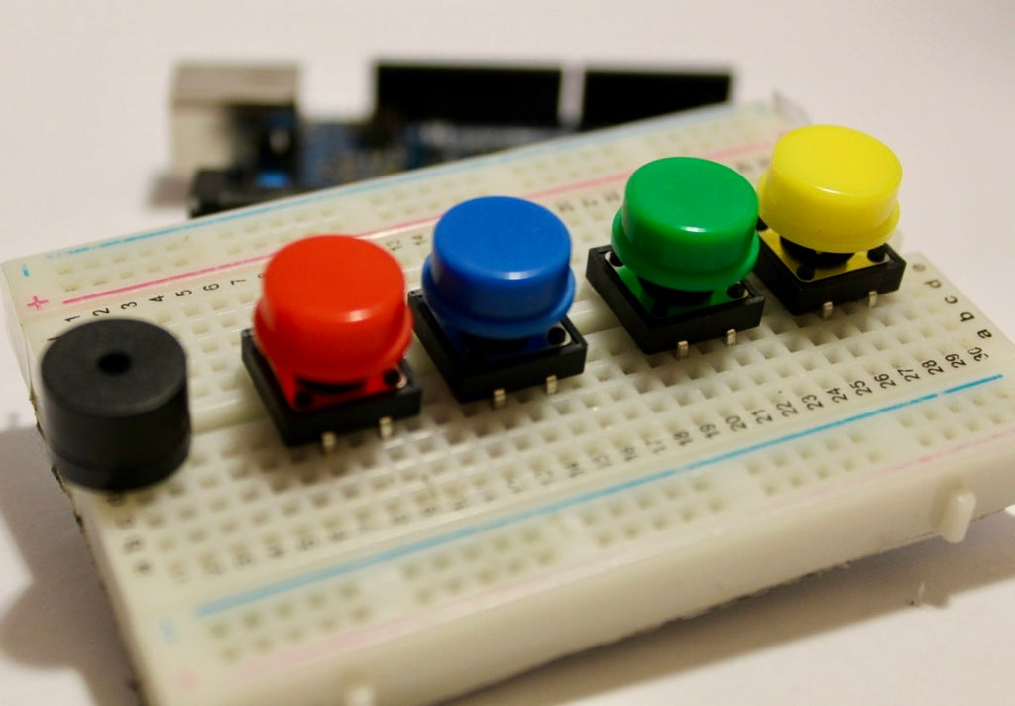
INTRODUCTION :
On this project, We will be going make a mini piano using an Arduino Uno.
This Mini Piano is very easy to make & minimum components have been used for it.
A Mini Piano Using Arduino UNO

Slide 3
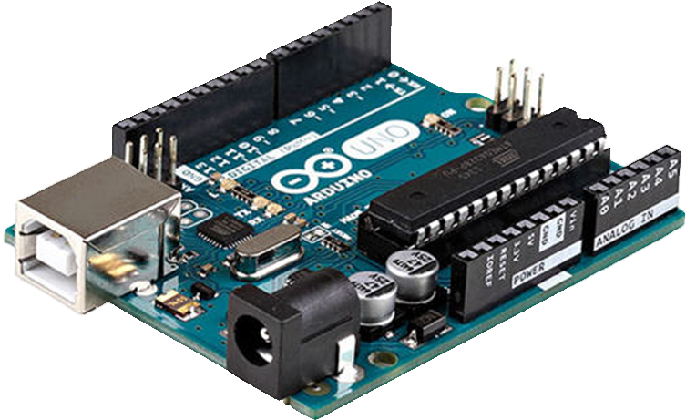
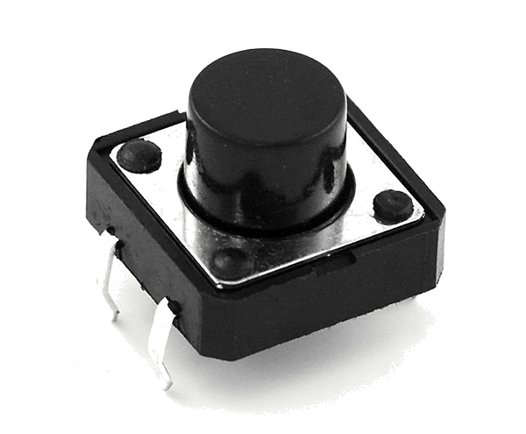
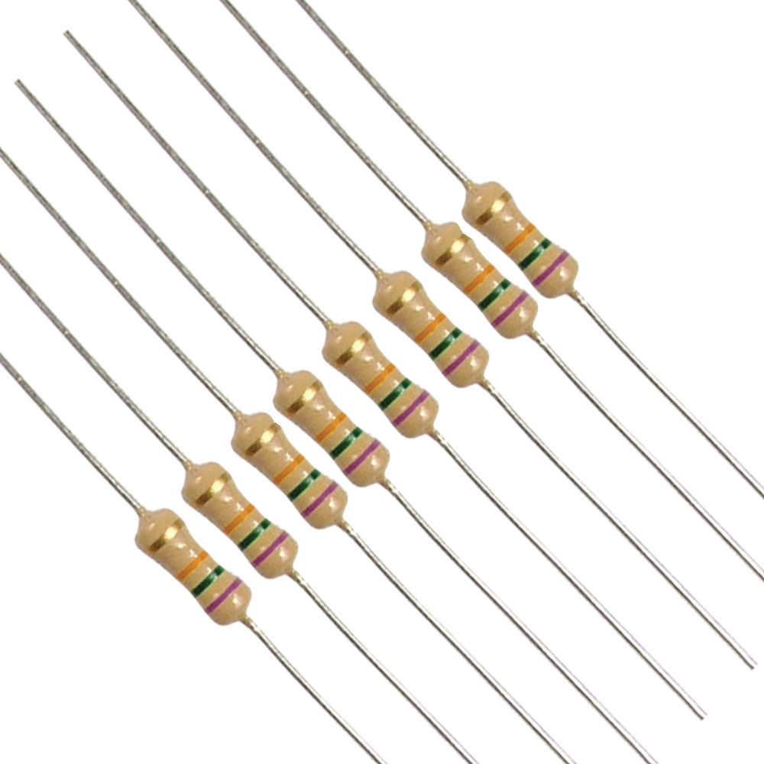
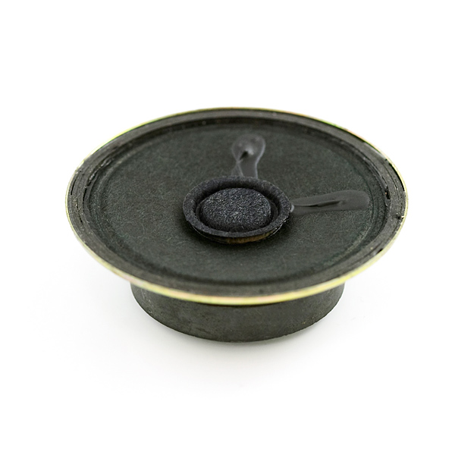
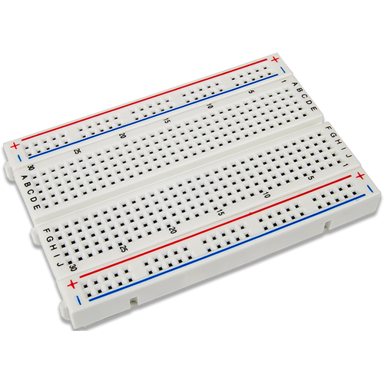
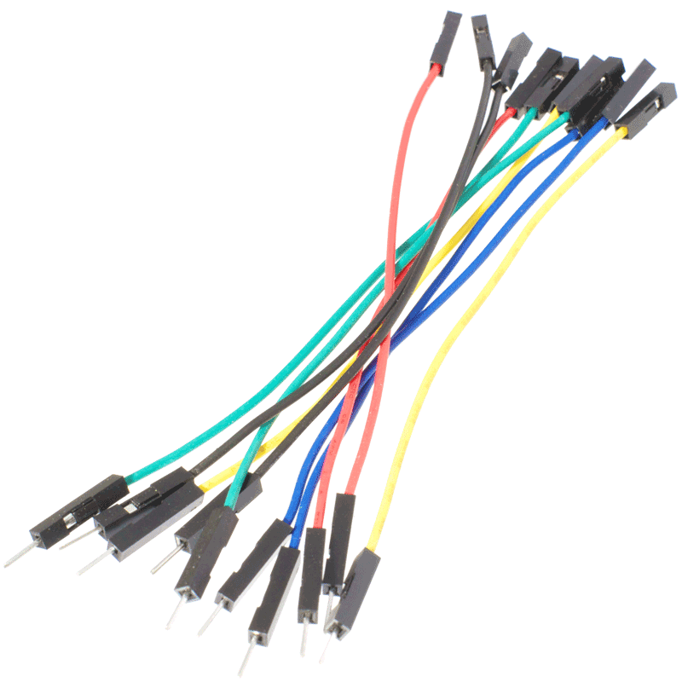
REQUIRED EQUIPMENTS :
PUSHBUTTON
10K RESISTOR
ARDUINO UNO
SPEAKER
BREADBOARD
JUMPER WIRES

Slide 4

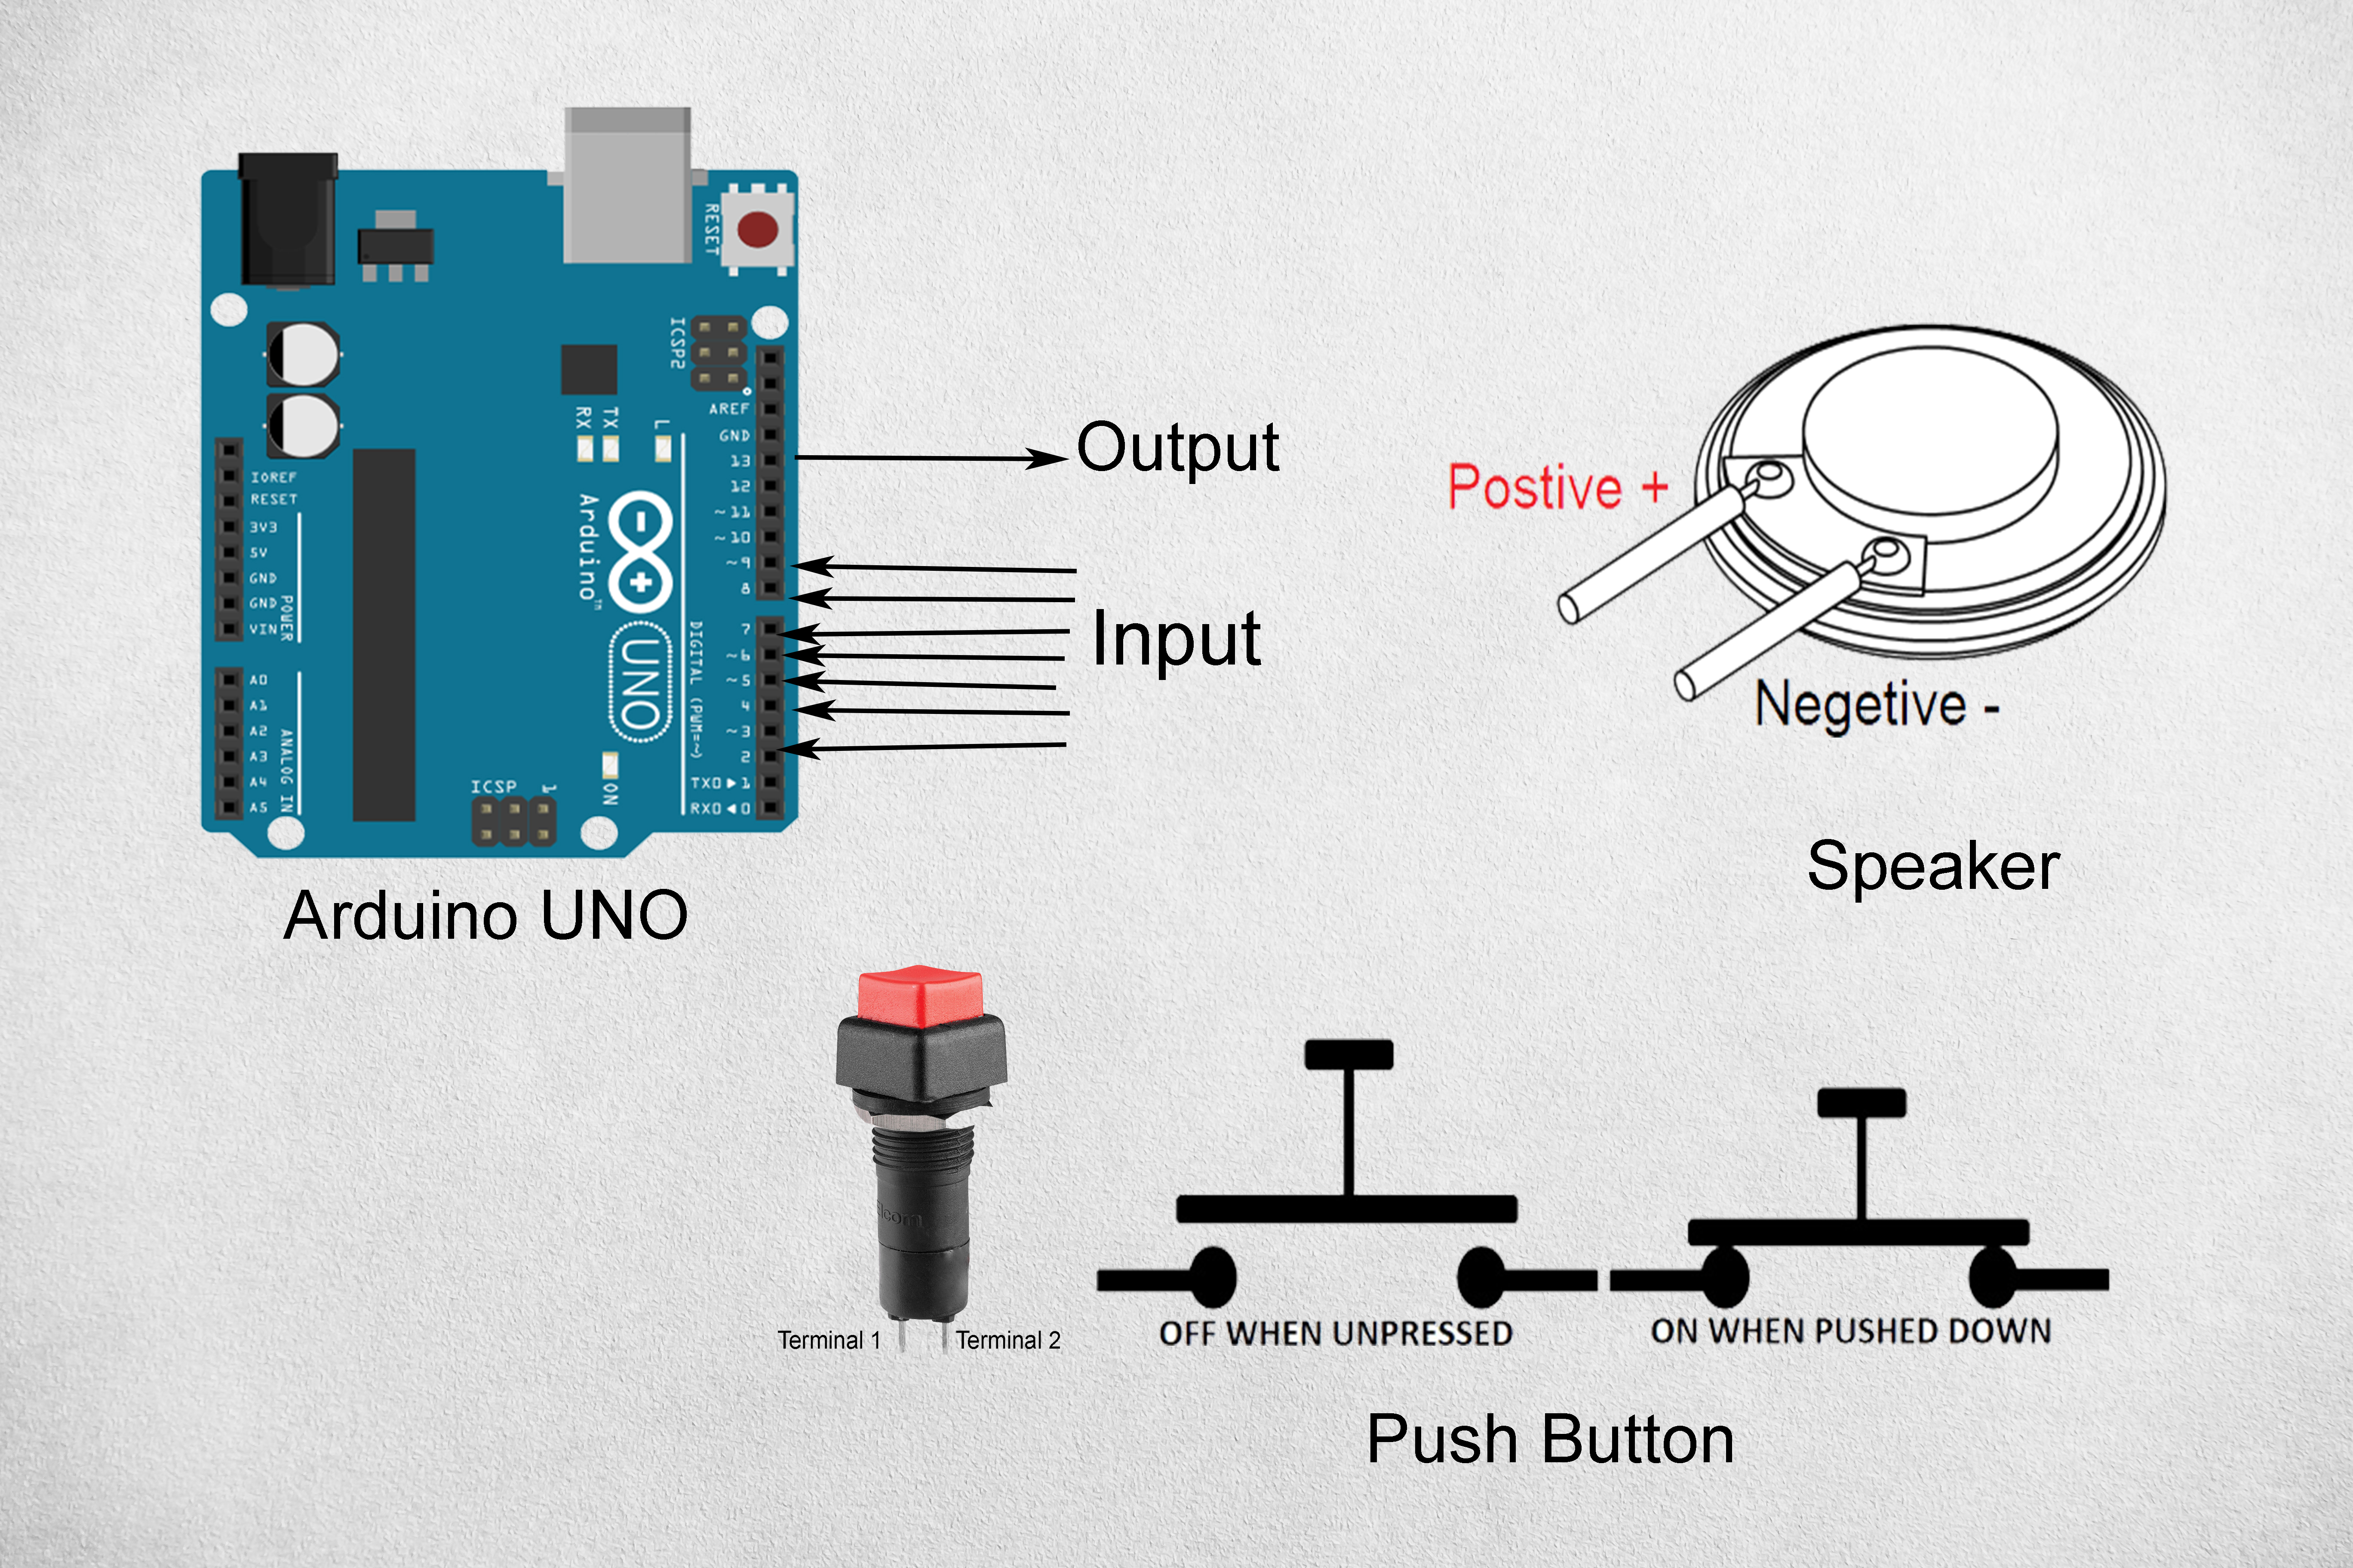
PIN DIAGRAM OF EQUIPMENTS :

Slide 5
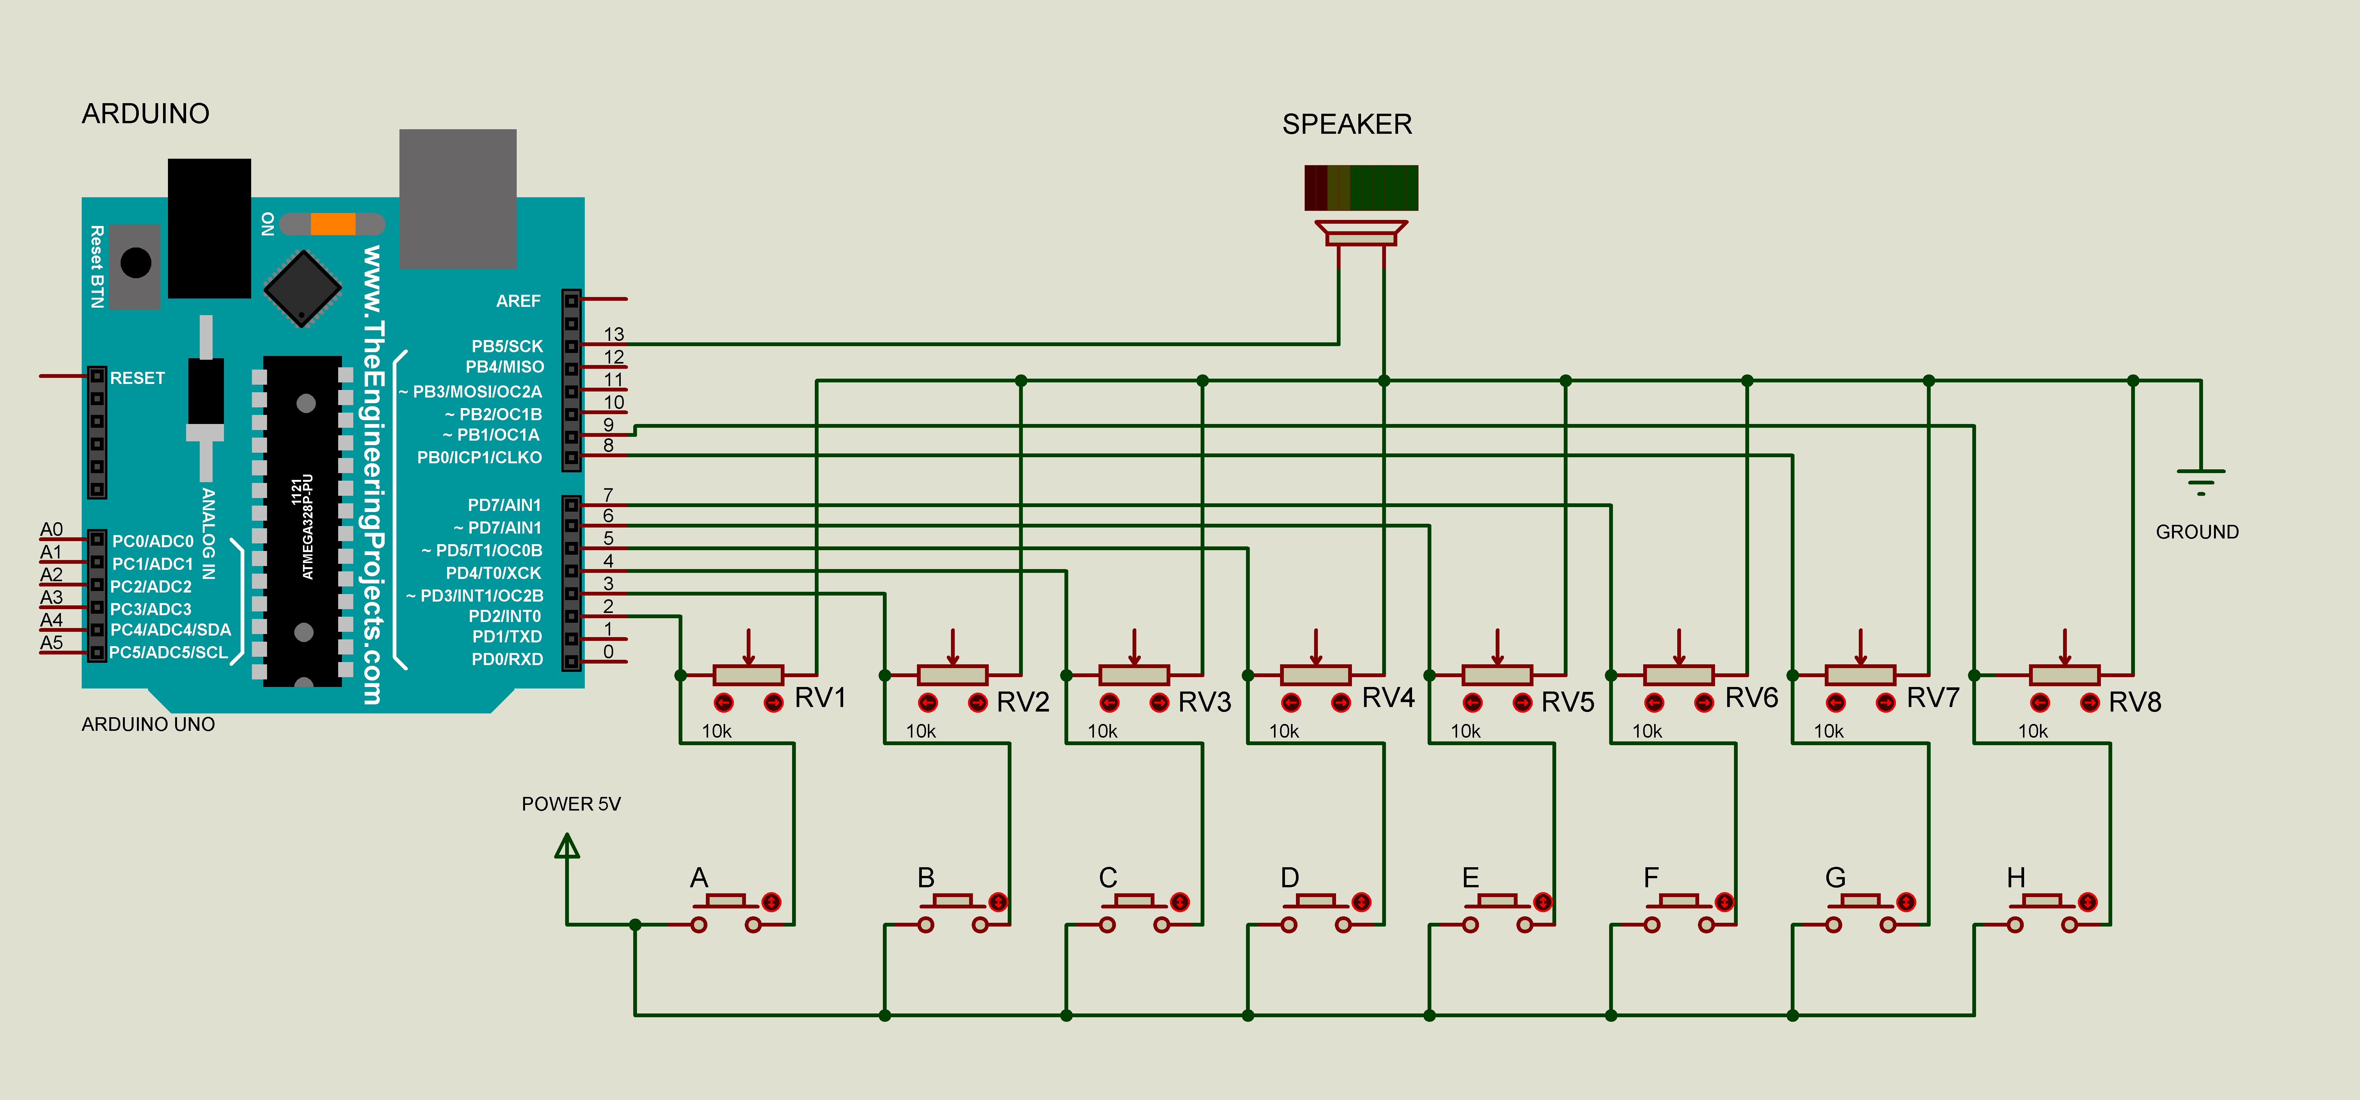
SCHEMATICS USING PROTEUS :

Slide 6
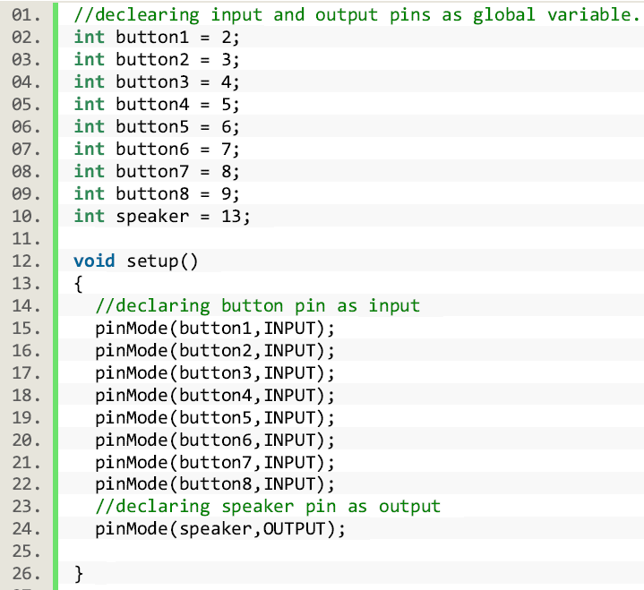
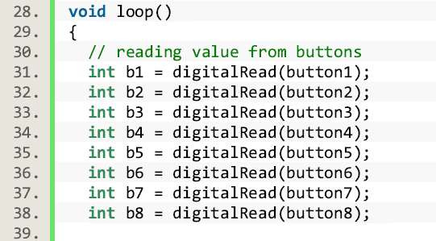
SKETCH FOR ARDUINO:

Slide 7
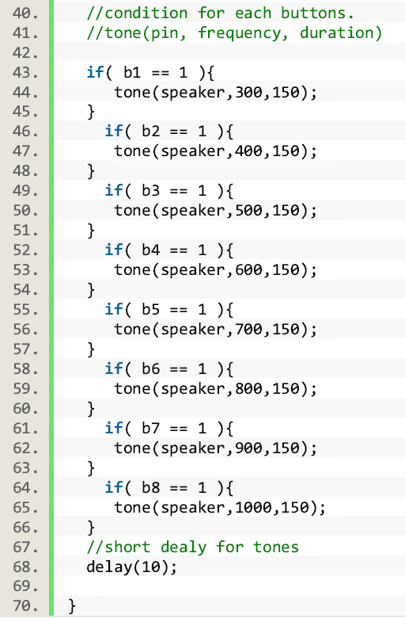

Slide 8
HOW THIS PROJECT WORKS :
On this project an Arduino uno will be connected with a speaker and some buttons. Each Buttons works as input and the speaker works as output.
Each time when we press a button, Arduino will generate a specific frequency tone and play that tone trough speaker for a certain period.

Slide 9
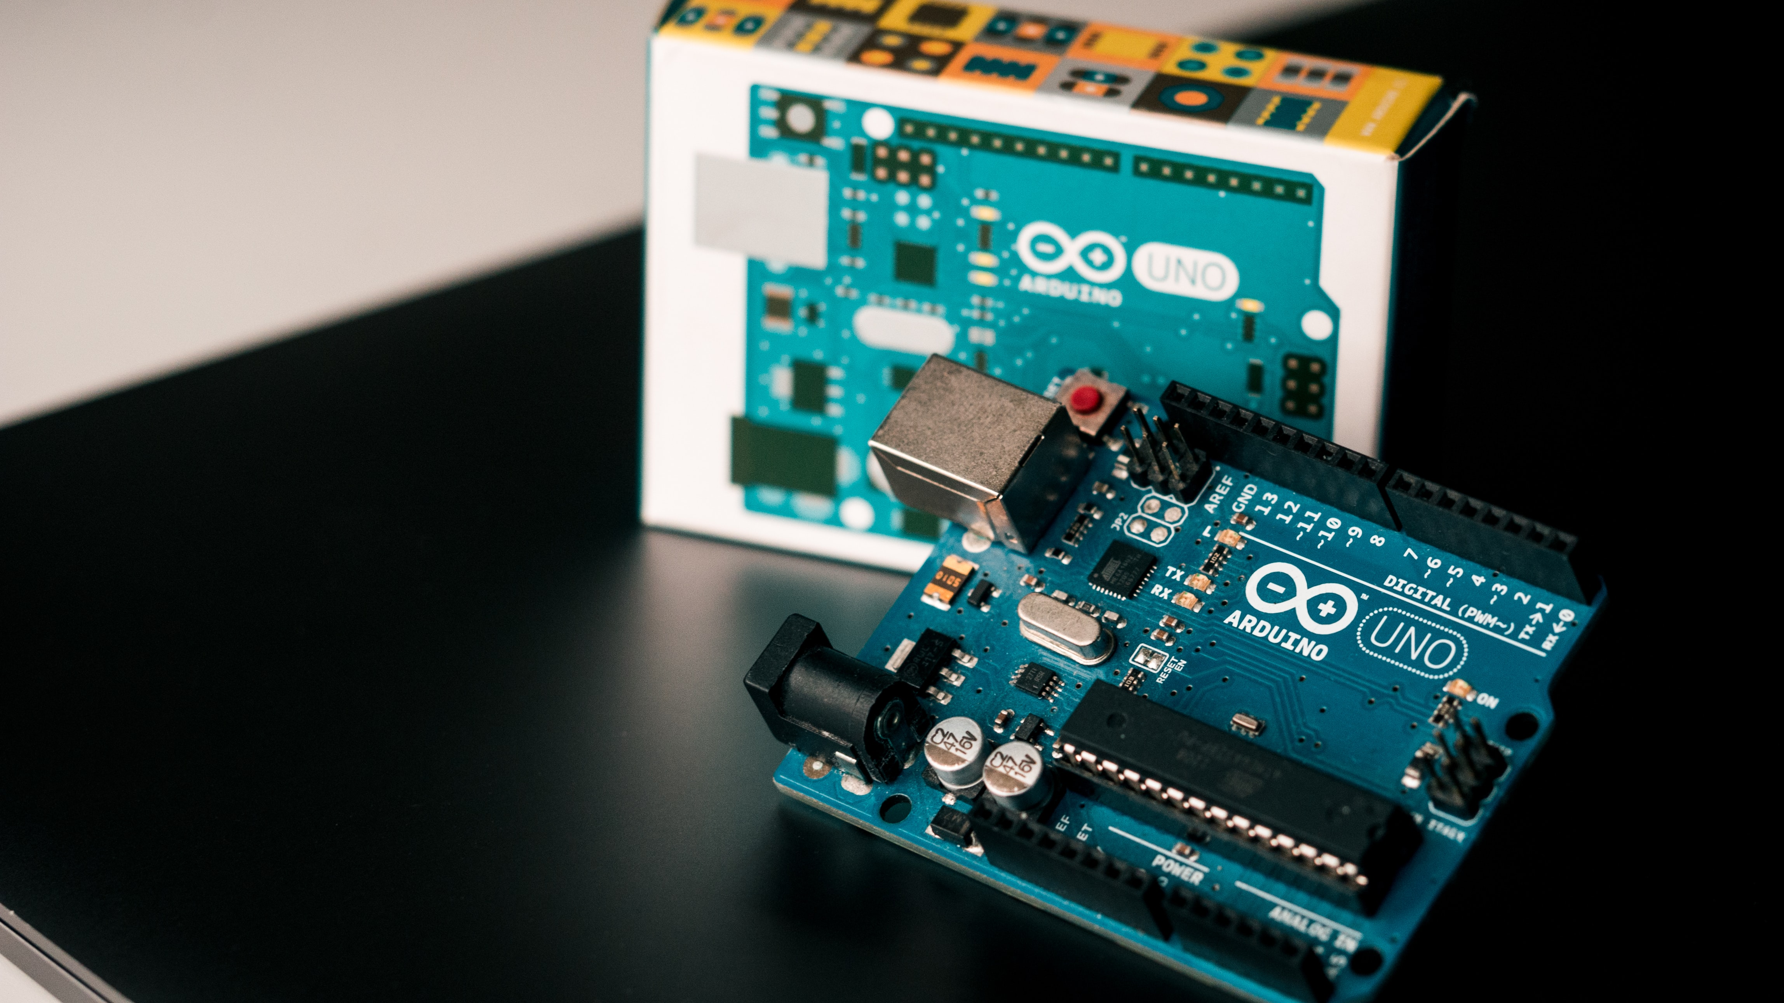
Thank You

